Slide 2
SEMANTIC WEB

Slide 3

Topic: Build a
Linked Open Data (LOD) application
Supervisor: Dr. Đỗ Bá Lâm
Students:
Đào Phan Khải 20232206M
Lê Hoàng Long 20232099M

Slide 4
Agenda
Define an ontology for the selected domain
Collect relevant data in this domain
Transform collected data into 4* standard
Find and establish links to other datasets to obtain 5* standard
Provide an interface via SPARQL endpoint/termnal to query data

Slide 5
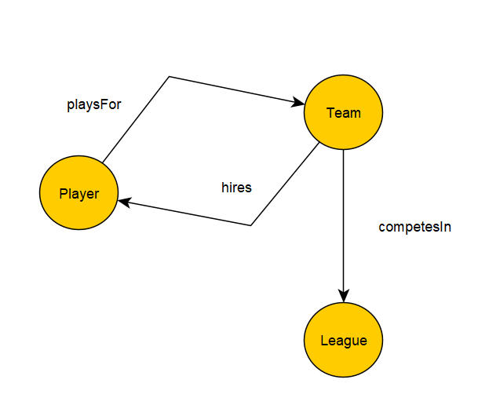
Define an ontology for the selected domain
The selected domain is European football league.
Classes
Team
Player
League

Slide 6
Define an ontology for the selected domain
Attributes
Team
Title
Homepage
Member of league
Link on Wikidata.org
Hires players
Season statistics
Goals, Shot per game
Number of yellow card, Number of red card
Percent of ball procession, Percent of successful ball passing
Percent of successful aerial, Rating

Slide 7
Define an ontology for the selected domain
Player
Name
Age
Field position
Nationality
External link on Wikidata.org
Play for a team
League
Title

Slide 8
Collect relevant data in the domain
Original dataset:
https://www.kaggle.com/datasets/vivovinco/20212022-football-player-stats
Processed dataset
https://github.com/hoanglong1712/Dai-Hoc-Bach-Khoa-Ha-Noi/tree/main/Web%20ng%E1%BB%AF%20ngh%C4%A9a%20Semantic%20Web/project%201%20version%202
Linked dataset:
https://www.wikidata.org/wiki/

Slide 9
Transform collected data into 4* standard
The raw data is in tabular format
Team | Tournament | Goals | Shots pg | yellow_cards | red_cards | Possession% | Pass% | AerialsWon | Rating
Manchester City | Premier League | 83 | 15.8 | 46 | 2 | 60.8 | 89.4 | 12.8 | 7.01
Rk | Player | Nation | Pos | Squad | Comp | Age | Born | MP | Starts | Min | 90s | Goals | Shots | SoT | SoT%
1 | Brenden Aaronson | USA | MFFW | Leeds United | Premier League | 22 | 2000 | 20 | 19 | 1596 | 17.7 | 1 | 1.53 | 0.28 | 18.5
2 | Yunis Abdelhamid | MAR | DF | Reims | Ligue 1 | 35 | 1987 | 22 | 22 | 1980 | 22 | 0 | 0.86 | 0.05 | 5.3

Slide 10
Transform collected data into 4* standard
Step to transform collected data to 4* standard
Tournament becomes http://www.semanticweb.org/ontologies/2025/football/League
Player becomes http://www.semanticweb.org/ontologies/2025/football/Player
Age becomes http://www.semanticweb.org/ontologies/2025/football/age
Pos becomes http://www.semanticweb.org/ontologies/2025/football/position

Slide 11
Transform collected data into 4* standard
Nation becomes http://www.semanticweb.org/ontologies/2025/football/nationality
Squad becomes http://www.semanticweb.org/ontologies/2025/football/Team

Slide 12
Establish links to other datasets to obtain 5* standard
Data enrichment
Link to Wikidata.org
Each player has a link to Wikidata.org
Each team has a link to Wikidata.org
Link to homepage
Each team has a link the its official homepage

Slide 13
Interface via SPARQL endpoint/termnal to query data
Collecting name of all teams and leagues
prefix owl: <http://www.w3.org/2002/07/owl#>
prefix rdf: <http://www.w3.org/1999/02/22-rdf-syntax-ns#>
prefix xml: <http://www.w3.org/XML/1998/namespace>
prefix xsd: <http://www.w3.org/2001/XMLSchema#>
prefix rdfs: <http://www.w3.org/2000/01/rdf-schema#>
PREFIX ex: <http://www.semanticweb.org/ontologies/2025/football/>
SELECT ?team ?league
WHERE {
?team rdf:type ex:Team . # Specify the Team class
?league rdf:type ex:League . # Specify the League class
?team ex:competesIn ?league . #
}

Slide 14
Interface via SPARQL endpoint/termnal to query data
Looking for the most scored team
prefix owl: <http://www.w3.org/2002/07/owl#>
prefix rdf: <http://www.w3.org/1999/02/22-rdf-syntax-ns#>
prefix xml: <http://www.w3.org/XML/1998/namespace>
prefix xsd: <http://www.w3.org/2001/XMLSchema#>
prefix rdfs: <http://www.w3.org/2000/01/rdf-schema#>
PREFIX ex: <http://www.semanticweb.org/ontologies/2025/football/>
SELECT ?team ?goals
WHERE {
?team rdf:type ex:Team ;
ex:goal ?goals .
}
ORDER BY DESC(xsd:integer(?goals))
LIMIT 1

Slide 15
Interface via SPARQL endpoint/termnal to query data
Looking for teams which process the ball at least 60% of time of all matches
prefix owl: <http://www.w3.org/2002/07/owl#>
prefix rdf: <http://www.w3.org/1999/02/22-rdf-syntax-ns#>
prefix xml: <http://www.w3.org/XML/1998/namespace>
prefix xsd: <http://www.w3.org/2001/XMLSchema#>
prefix rdfs: <http://www.w3.org/2000/01/rdf-schema#>
PREFIX ex: <http://www.semanticweb.org/ontologies/2025/football/>
SELECT ?team ?possession
WHERE {
?team a ex:Team ;
ex:procession_percentage ?possession .
FILTER(xsd:decimal(?possession) > 60)
}

Slide 16
Interface via SPARQL endpoint/termnal to query data
Counting the number of team
prefix owl: <http://www.w3.org/2002/07/owl#>
prefix rdf: <http://www.w3.org/1999/02/22-rdf-syntax-ns#>
prefix xml: <http://www.w3.org/XML/1998/namespace>
prefix xsd: <http://www.w3.org/2001/XMLSchema#>
prefix rdfs: <http://www.w3.org/2000/01/rdf-schema#>
PREFIX ex: <http://www.semanticweb.org/ontologies/2025/football/>
SELECT (COUNT(?team) AS ?teamCount)
WHERE {
?team a ex:Team .
}

Slide 17
Interface via SPARQL endpoint/termnal to query data
Looking for teams which get the biggest number of red card
prefix owl: <http://www.w3.org/2002/07/owl#>
prefix rdf: <http://www.w3.org/1999/02/22-rdf-syntax-ns#>
prefix xml: <http://www.w3.org/XML/1998/namespace>
prefix xsd: <http://www.w3.org/2001/XMLSchema#>
prefix rdfs: <http://www.w3.org/2000/01/rdf-schema#>
PREFIX ex: <http://www.semanticweb.org/ontologies/2025/football/>
SELECT ?team ?red_cards
WHERE {
?team rdf:type ex:Team ;
ex:red_card ?red_cards .
}
ORDER BY DESC(xsd:integer(?red_cards))
LIMIT 1

Slide 18
Interface via SPARQL endpoint/termnal to query data
Calculating the average number of yellow cards of all teams
prefix owl: <http://www.w3.org/2002/07/owl#>
prefix rdf: <http://www.w3.org/1999/02/22-rdf-syntax-ns#>
prefix xml: <http://www.w3.org/XML/1998/namespace>
prefix xsd: <http://www.w3.org/2001/XMLSchema#>
prefix rdfs: <http://www.w3.org/2000/01/rdf-schema#>
PREFIX ex: <http://www.semanticweb.org/ontologies/2025/football/>
SELECT (AVG(xsd:integer(?yellow_card)) AS ?avgYellowCards)
WHERE {
?record ex:yellow_card ?yellow_card .
}

Slide 19
Interface via SPARQL endpoint/termnal to query data
Sort the list of teams in descending order of ball passing rate
prefix owl: <http://www.w3.org/2002/07/owl#>
prefix rdf: <http://www.w3.org/1999/02/22-rdf-syntax-ns#>
prefix xml: <http://www.w3.org/XML/1998/namespace>
prefix xsd: <http://www.w3.org/2001/XMLSchema#>
prefix rdfs: <http://www.w3.org/2000/01/rdf-schema#>
PREFIX ex: <http://www.semanticweb.org/ontologies/2025/football/>
SELECT ?team ?pass_percentage
WHERE {
?team rdf:type ex:Team ;
ex:pass_percentage ?pass_percentage .
}
ORDER BY DESC(xsd:decimal(?pass_percentage))

Slide 20
THANK YOU !

